Slide 1
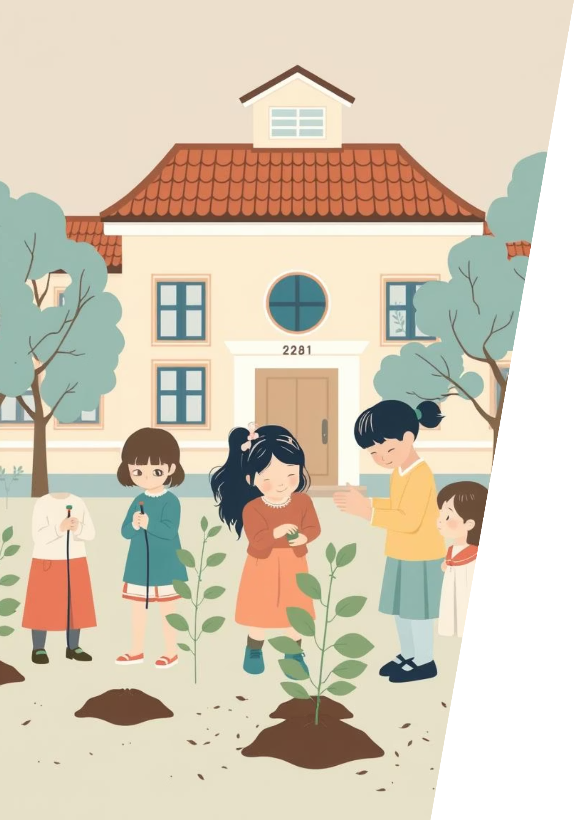
Integrated Science – Climate Change and Humans
This presentation explores how climate change affects our daily lives and what we can do about it. We'll learn about the causes of climate change, its effects on humans, and practical ways we can help protect our planet.

Slide 2
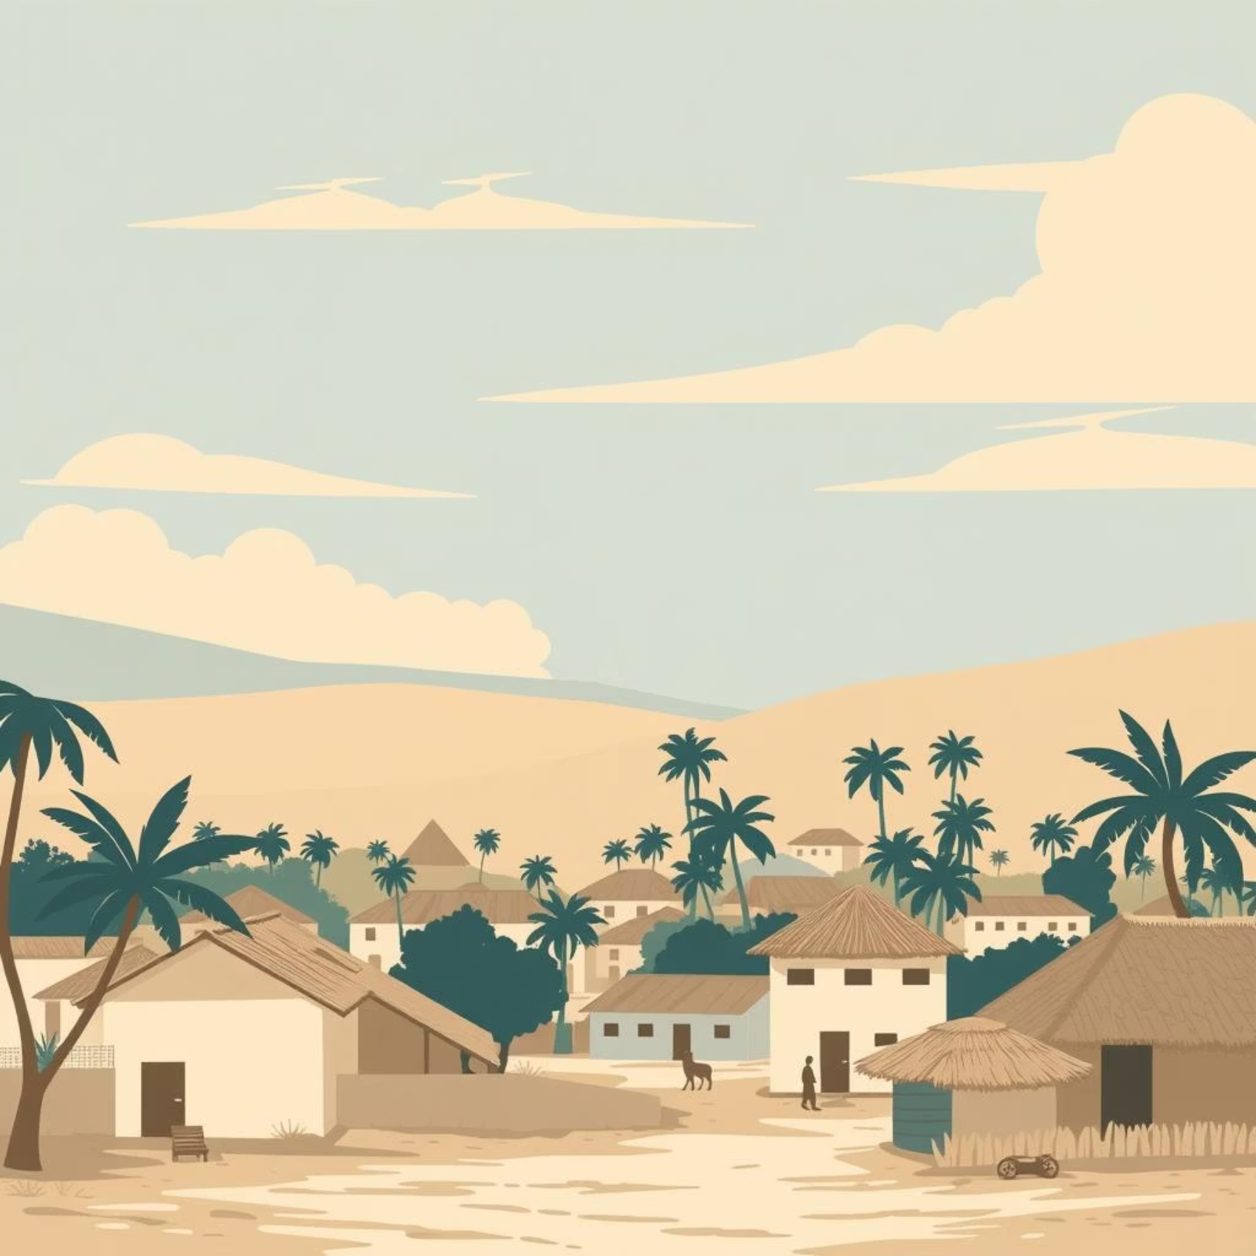
What is Climate?
Climate is how the weather usually is in a place over a long period of time. It's the pattern of weather that repeats year after year.
For example: In Ghana, it is mostly hot and rainy in some months, and dry in others. This predictable pattern is Ghana's climate.

Slide 3
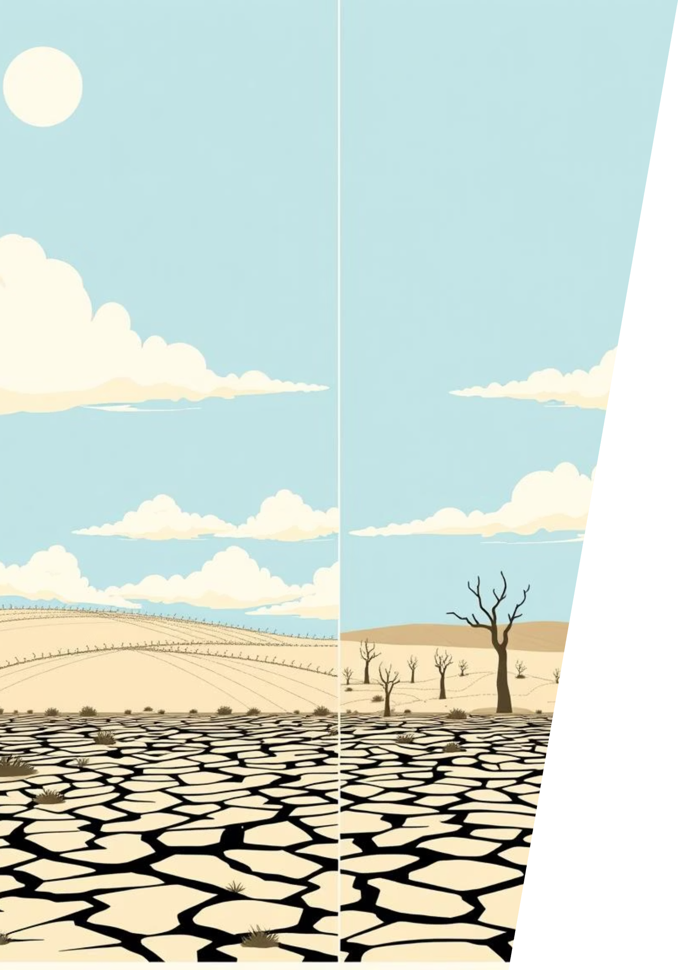
What is Climate Change?
Changing Patterns
Global Effects
Climate change means the usual weather is changing over time in ways that aren't normal.
Some places are getting hotter, others have too much rain or too little rain.
Multiple Causes
Both humans and nature can cause these changes, but human activities are speeding up the process.

Slide 4




Causes of Climate Change: Human Activities
Cutting Trees
Burning Fuel
Fewer trees means fewer plants to clean the air and absorb carbon dioxide.
Cars, buses, and factories release gases that trap heat in our atmosphere.
Factory Pollution
Bad Farming
Industrial smoke pollutes the air and contributes to global warming.
Overusing land makes soil poor and dry, reducing its ability to support plants.

Slide 5
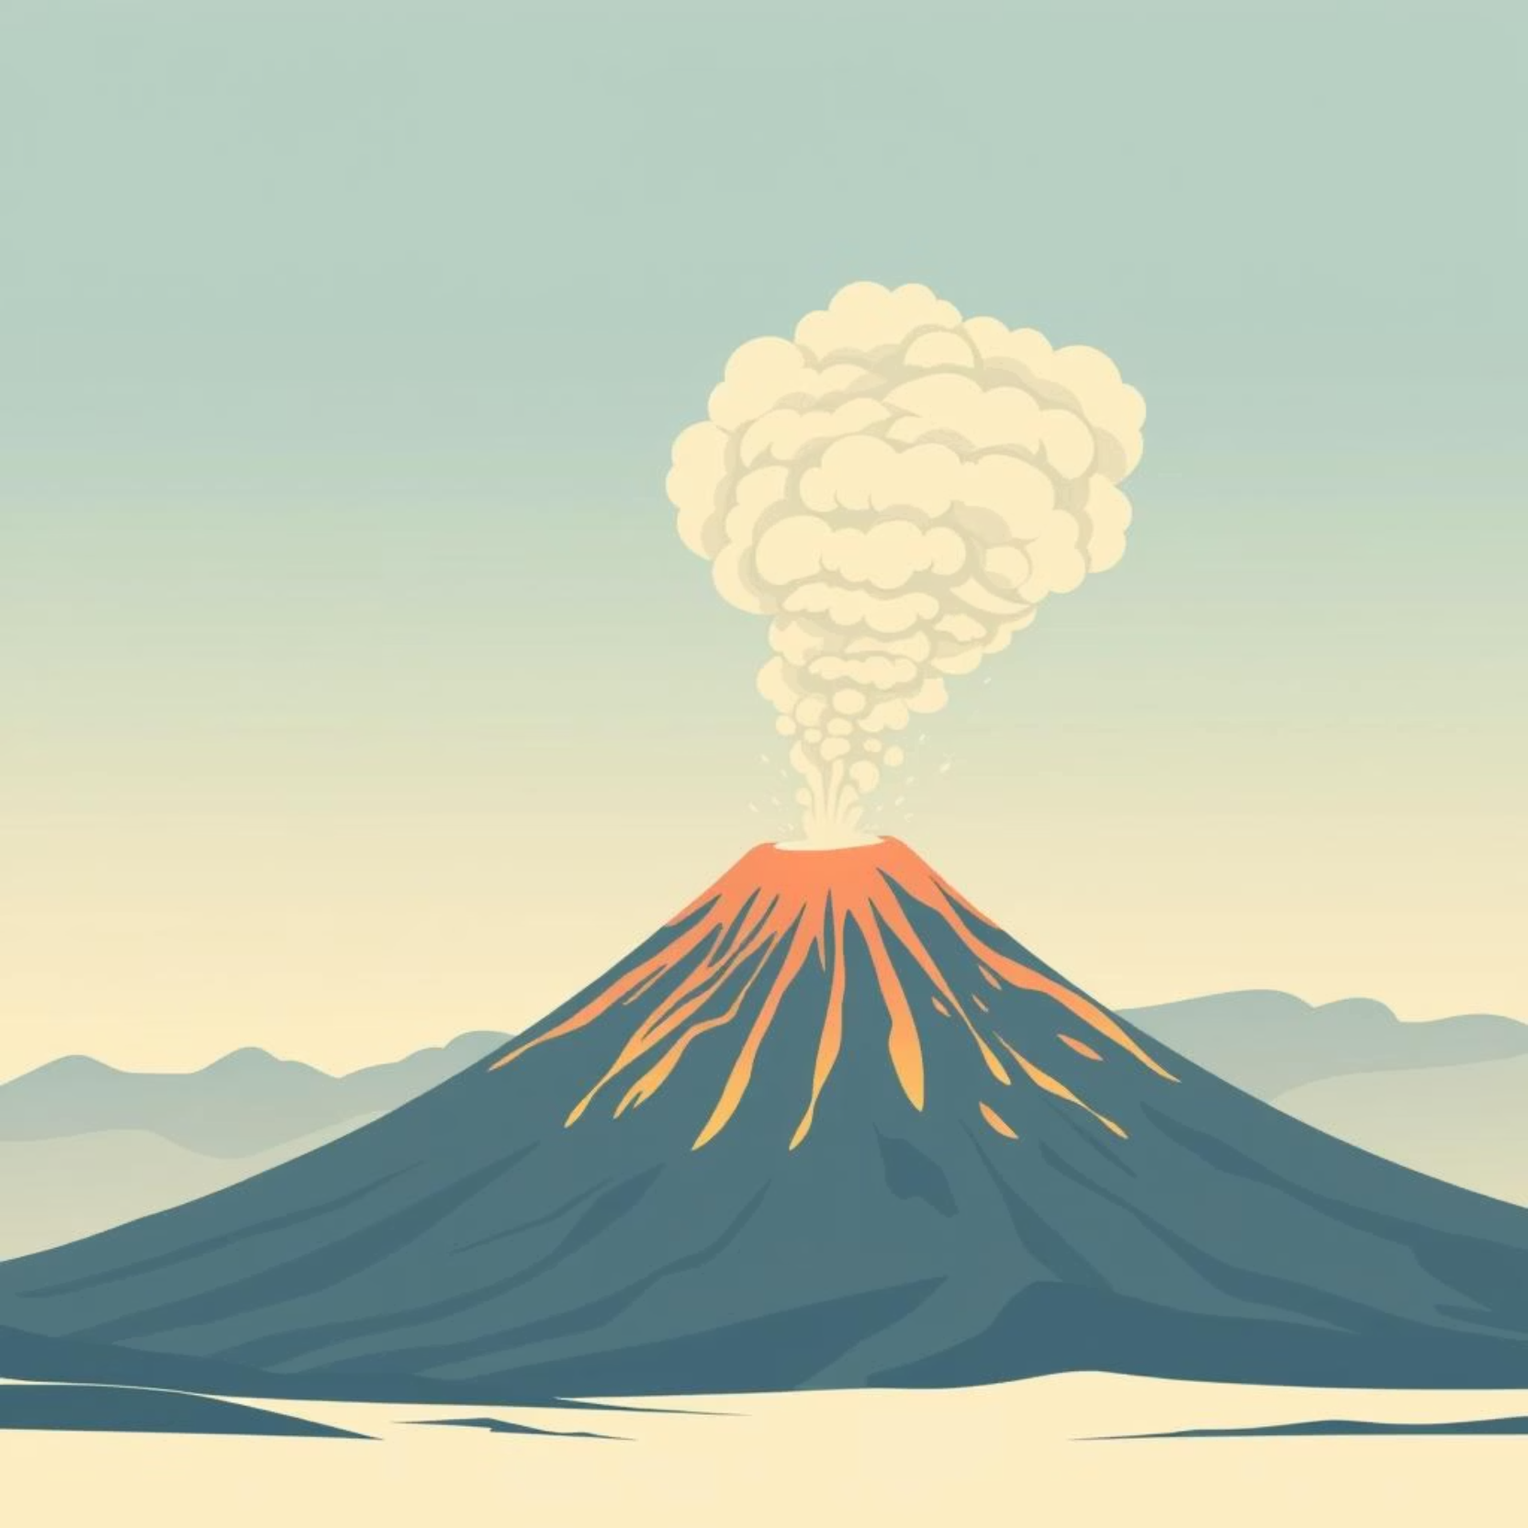
Causes of Climate Change: Natural Factors
Volcanic Eruptions
Volcanoes erupt and send smoke and particles into the air, which can temporarily cool the Earth.
Solar Changes
Sometimes the sun's heat output changes naturally, affecting Earth's temperature.
Earth's Natural Cycles
Over long periods, some areas become hotter or colder naturally due to Earth's orbital changes.

Slide 6
Effects of Climate Change on Humans
Problem
How It Affects Us
Example
Floods
Homes and roads destroyed; people must relocate
Rainy season floods in Accra or Tema
Droughts
No water or food; plants die
Farmers in northern Ghana lose crops
Extreme Heat
People feel tired, may faint
Heat waves in Accra during dry season
Disease Spread
Mosquitoes and germs increase
More malaria and cholera after floods

Slide 7
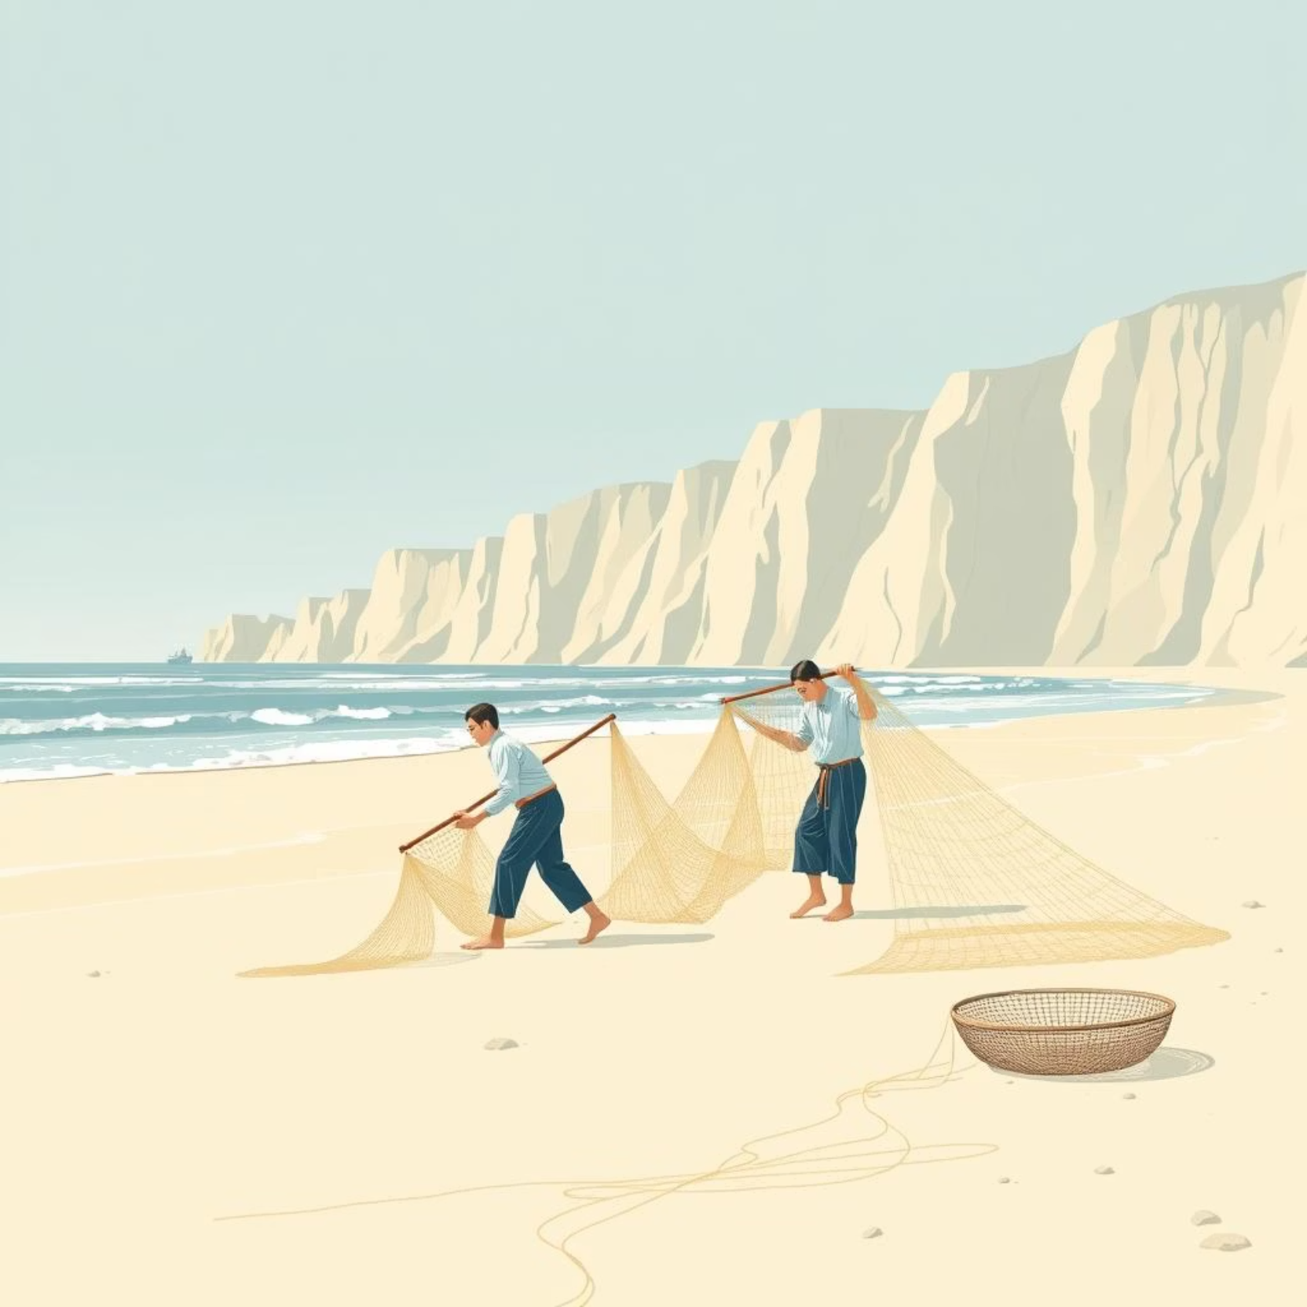
More Effects of Climate Change
Economic Impact
Loss of jobs and food sources as farmers and fishermen suffer from changing conditions
Coastal Threats
Rising sea levels cause coastal areas to flood, affecting communities like Jamestown and Keta

Slide 8




How Humans Make Climate Change Worse
Transportation
Deforestation
Driving cars frequently releases greenhouse gases that make the air dirty
Cutting down trees means fewer plants to absorb carbon dioxide and cool the Earth
Waste
Energy Use
Throwing waste on land or in rivers pollutes the environment and releases methane
Using too much electricity leads to more fossil fuel burning and pollution

Slide 9
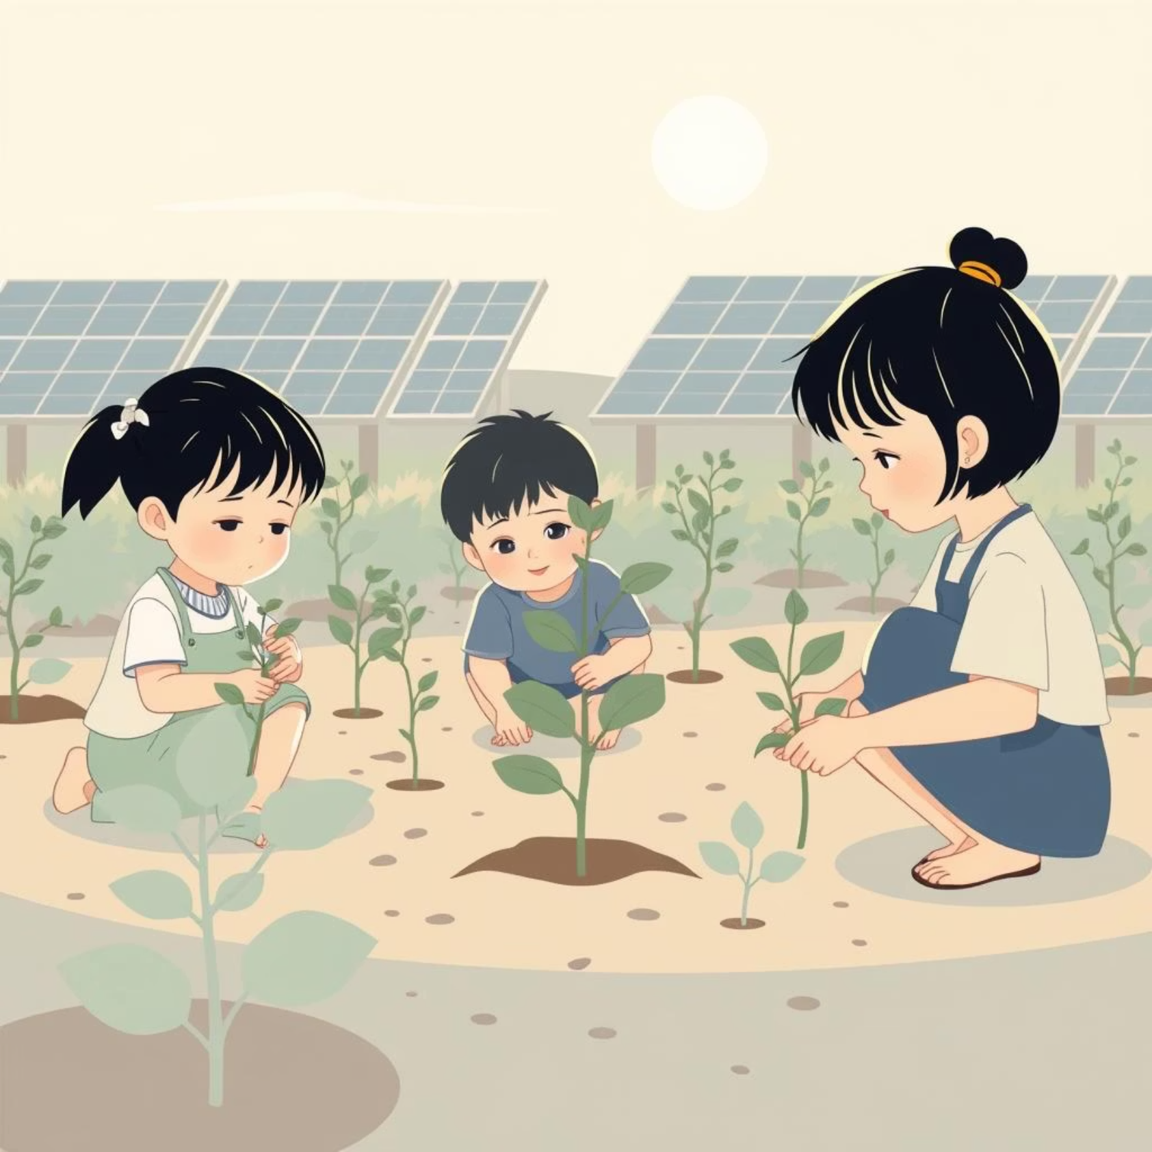
How Humans Can Help Stop Climate Change
1
Plant Trees
Trees clean the air and cool the Earth by absorbing carbon dioxide
2
Use Clean Energy
Solar or wind power instead of fossil fuels reduces harmful emissions
3
Reduce Waste
Recycle, reuse items, and throw less trash to minimize pollution
4
Conserve Resources
Save water and electricity; walk or use public transport when possible

Slide 10
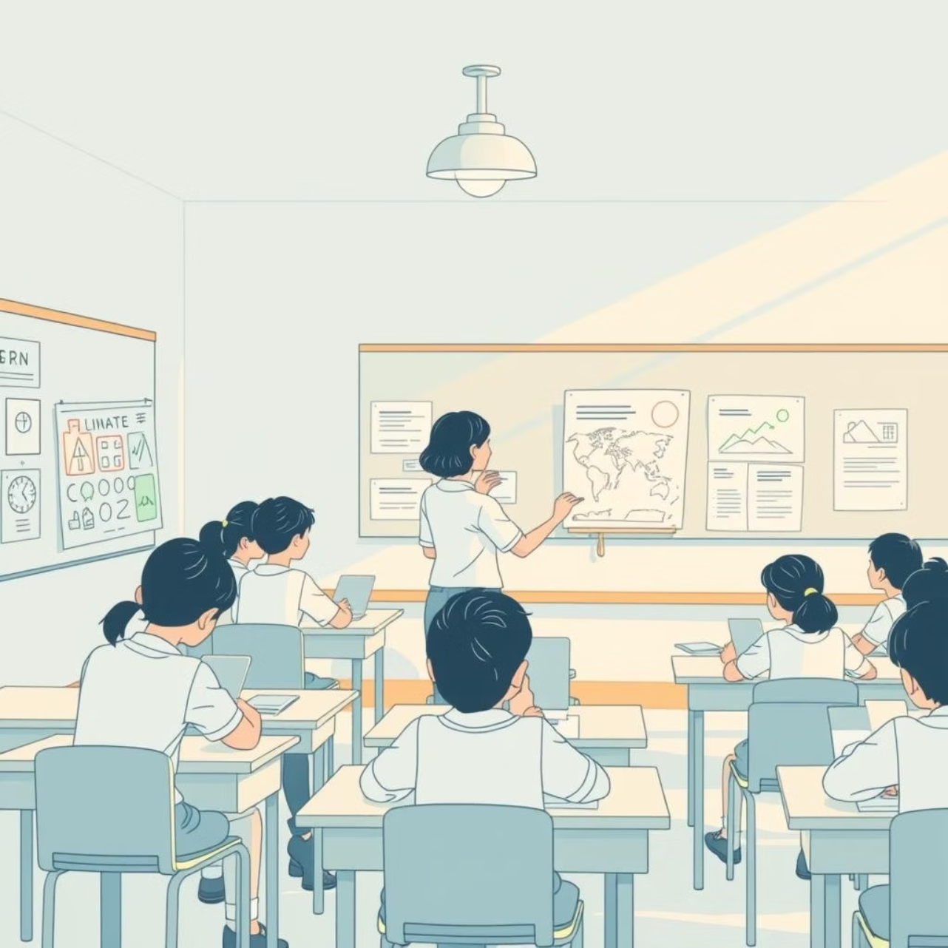
Summary & Teaching Ideas
Key Points
Climate change means the usual weather patterns are changing
It causes floods, droughts, extreme heat, disease, and food problems
Humans can help by planting trees, saving energy, reducing waste
Teaching others about climate action is important
Classroom Activities
Ask pupils: "How do you help the Earth at home or school?"
Show pictures of climate impacts like floods or dry farms
Let pupils draw one action they can take to help the planet

